Slide 1
Microsoft Teams
The hub for teamwork in Office 365
Name
Date

Slide 2

A changing modern workplace
Mobile and social
45% use social tools at work
4X as many devices per user
Diverse and global
5 generations together in the workforce
72% of workers will be working remotely by 2020
Team-based and collaborative
2x as many teams
80% of employee time is spent collaborating
Notes:
The way in which organizations work has evolved. Both work styles and the workforce are becoming more and more diverse. There are several trends – and challenges – that we’re seeing.
[MOBILE AND SOCIAL]
When people collaborate today, they leverage social tools– 45% use social technologies in their day-to-day work³.
Users also work across more devices - in the past five years, the number of devices per user has increased 400%.⁴ The mobile phone has completely changed how we communicate and work. Many users live on their phone. In addition, people use different apps and services resulting in them having to jump between different experiences during the day.
[DIVERSE AND GLOBAL]
The workforce itself is more diverse. For the first time, there are five generations together in the workplace, – all with different background in technology and different expectations about communication and collaboration tools. For example (hold up phone if available), some people are comfortable chatting on a phone, others prefer e-mail, or face to face.
Teams are increasingly geo distributed. Employees are no longer necessarily in the same office, let alone the same time zone. Per IDC, 72.3 percent of employees will be working remotely by 2020⁵, making it more challenging to have face-to-face conversations. There’s a greater need to enable communications and collaboration – regardless of geography.
[TEAM-BASED AND COLLABORATIVE]
There is also a movement towards transparency and inclusivity in how decisions are made. Organization structures are becoming more flat. People are on twice as many teams as they were five years ago.¹
And those teams are dynamic. It's rare that people don’t change on a multi-month project. And when someone leaves, the first step is for all to go through their e-mail to find the information needed to get the new person up to speed.
Being on more teams has also led to a dramatic increase in the amount of collaboration. The new way of work is team-based and collaborative. Workers report that 80 % of their time at work is spent collaborating.² (i.e. in meetings, calls)
[probe if the customer is experiencing some of the above to personalize the presentation]
[MAIN POINT TO LAND] We built Microsoft Teams in response to these communication and collaboration trends in the modern workplace. We’ve seen that Teams really thrive when information is shared in an open and transparent way and when people with diverse workstyles can access information easily. We’ve built Teams to enable that.
We’ve also seen that there is no one size fits all. We’ve built teams to be flexible and so that you can customize and personalize it based on the needs of your team.
What happens when you don’t provide tools to support these new workstyles? End users simply download the consumer grade tools to do the immediate task at hand. This creates friction for end users as they have to manage multiple logins and move between different experiences, and it creates risk for the organization as shadow IT develops.
[This video illustrates the problem with fragmented, best of breed solutions and is included for your background knowledge only, not to show in the customer meeting.]
¹ 2009, 2014 US IW Survey
² How much workplace collaboration is too much?
³ 2017, McKinsey Global Institute Survey Advanced social technologies and the future of collaboration
⁴ Survey Reveals Skyrocketing Usage and Growing IT Maturity in Enterprise Mobility
⁵ IDC Forecasts U.S. Mobile Worker Population to Surpass 105 Million by 2020

Slide 3
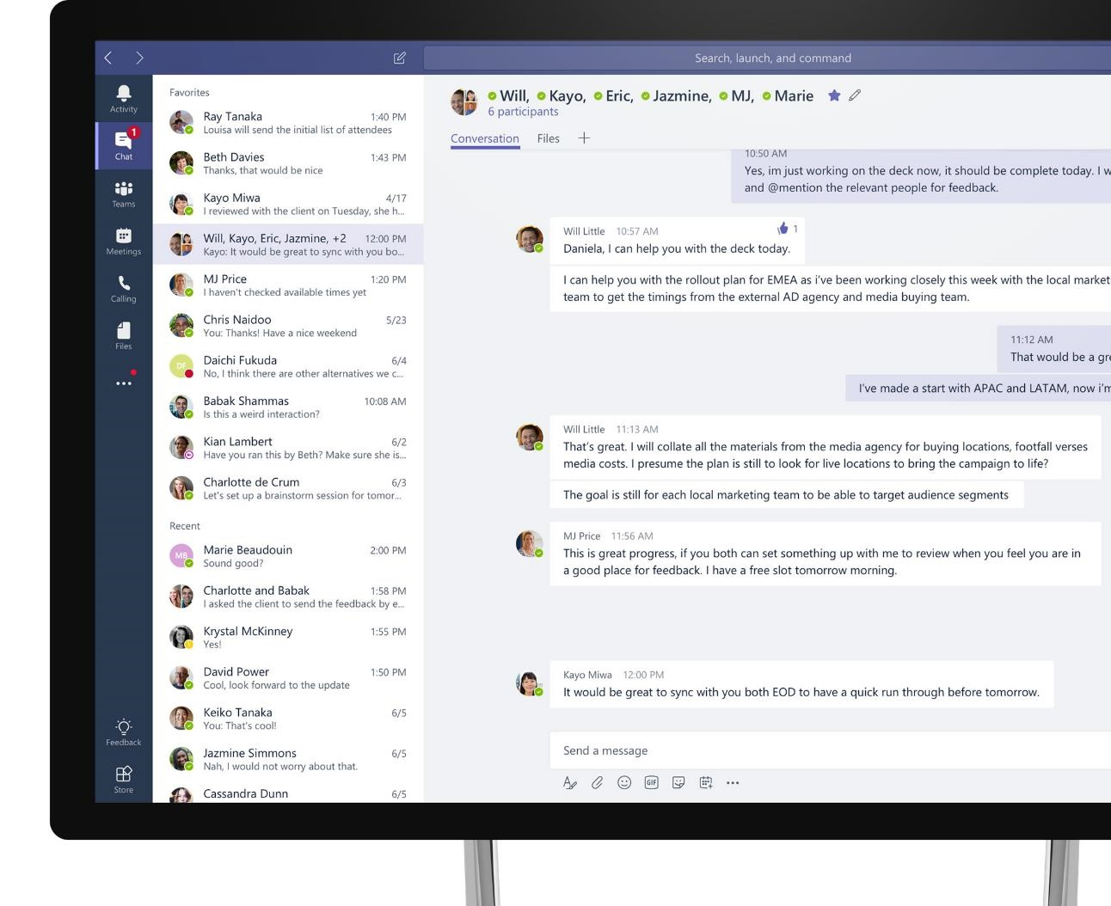
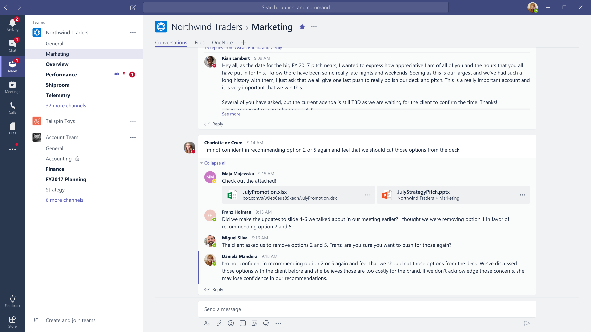








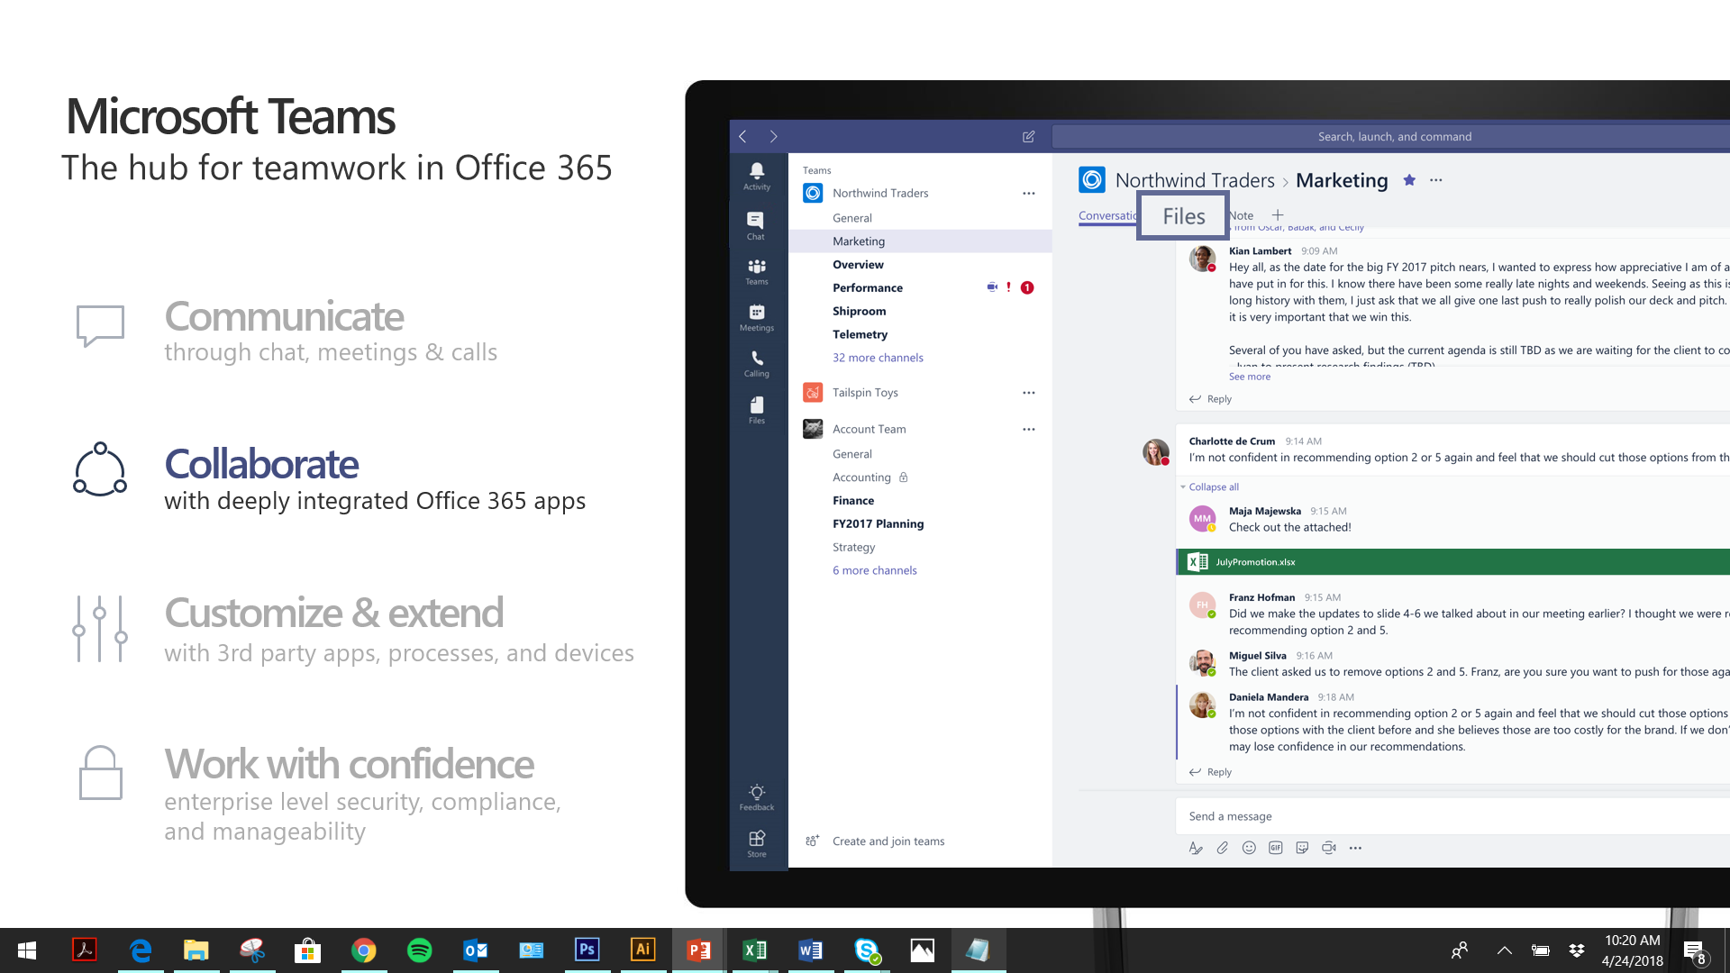



Microsoft Teams
The hub for teamwork in Office 365
Communicate
through chat, meetings & calls
Collaborate
with deeply integrated Office 365 apps
Customize & extend
with 3rd party apps, processes, and devices
Work with confidence
enterprise level security, compliance, and manageability
Notes:
[This is an animated slide. Please show it in presentation mode]
[MAIN POINT TO LAND]
Microsoft Teams is a hub for teamwork, a chat-based workspace that enables teams to be more productive by giving them a single and secure location that brings together everything a team needs: chats, meetings, calls, files, and tools. Microsoft Teams is one place for all the needs your teams have.
Microsoft Teams delivers on four core promises to create a digital workspace for high performing teams.
[COMMUNICATE]
First, Microsoft Teams solves for the communication needs of a diverse workforce.
Since preview, Microsoft Teams has evolved to include a complete meetings experience, as well as chat, voice and video -
You can use Teams for informal 1:1 or group chats – directly on your phone if you’re on the go. Or you can have an open conversation in a channel. This enables people to share information in a transparent way to accelerate decision making. And it's super easy to move from a chat into a face to face meeting, helping you to bridge geographical barriers.
[COLLABORATE]
When it comes to collaboration, the deep Office integration enables today’s multigenerational workforce to use the Office apps they are familiar with and love - Word, Excel, PowerPoint, OneNote, SharePoint, Planner, even Power BI - right within the context of Teams. Teams is unique in how we enable collaboration.
Today, when you want somebody’s feedback, you send them the file via email, they store it locally with comments, you store it again…… it's a vicious cycle that results in v2, v3, v4 versions – and you have to jump between email and other apps to get the work done. Teams brings all the Office 365 services together – so that you can easily share and co-author files without the need for email attachments.
[CUSTOMIZE]
Many of you use other services than Office 365 as well which results in you having to jump between and spend time in disparate experiences. We built Teams to not only be the hub for Office 365 services, but for all the services and tools teams use on a day to day basis. So, you can customize Teams with tabs, connector and bots to include the apps and services you need - <mention relevant 3rd party apps like GitHub and Trello that can be included in Teams>– we have integrations with over 150 partners. For our developer community, we have also created an extensible platform, to enable building apps and to integrate with business processes.
[WORK WITH CONFIDENCE]
Microsoft Teams comes with the enterprise grade security, compliance and manageability that you expect from Office 365 which customers tell us is a huge value add for them.

Slide 4
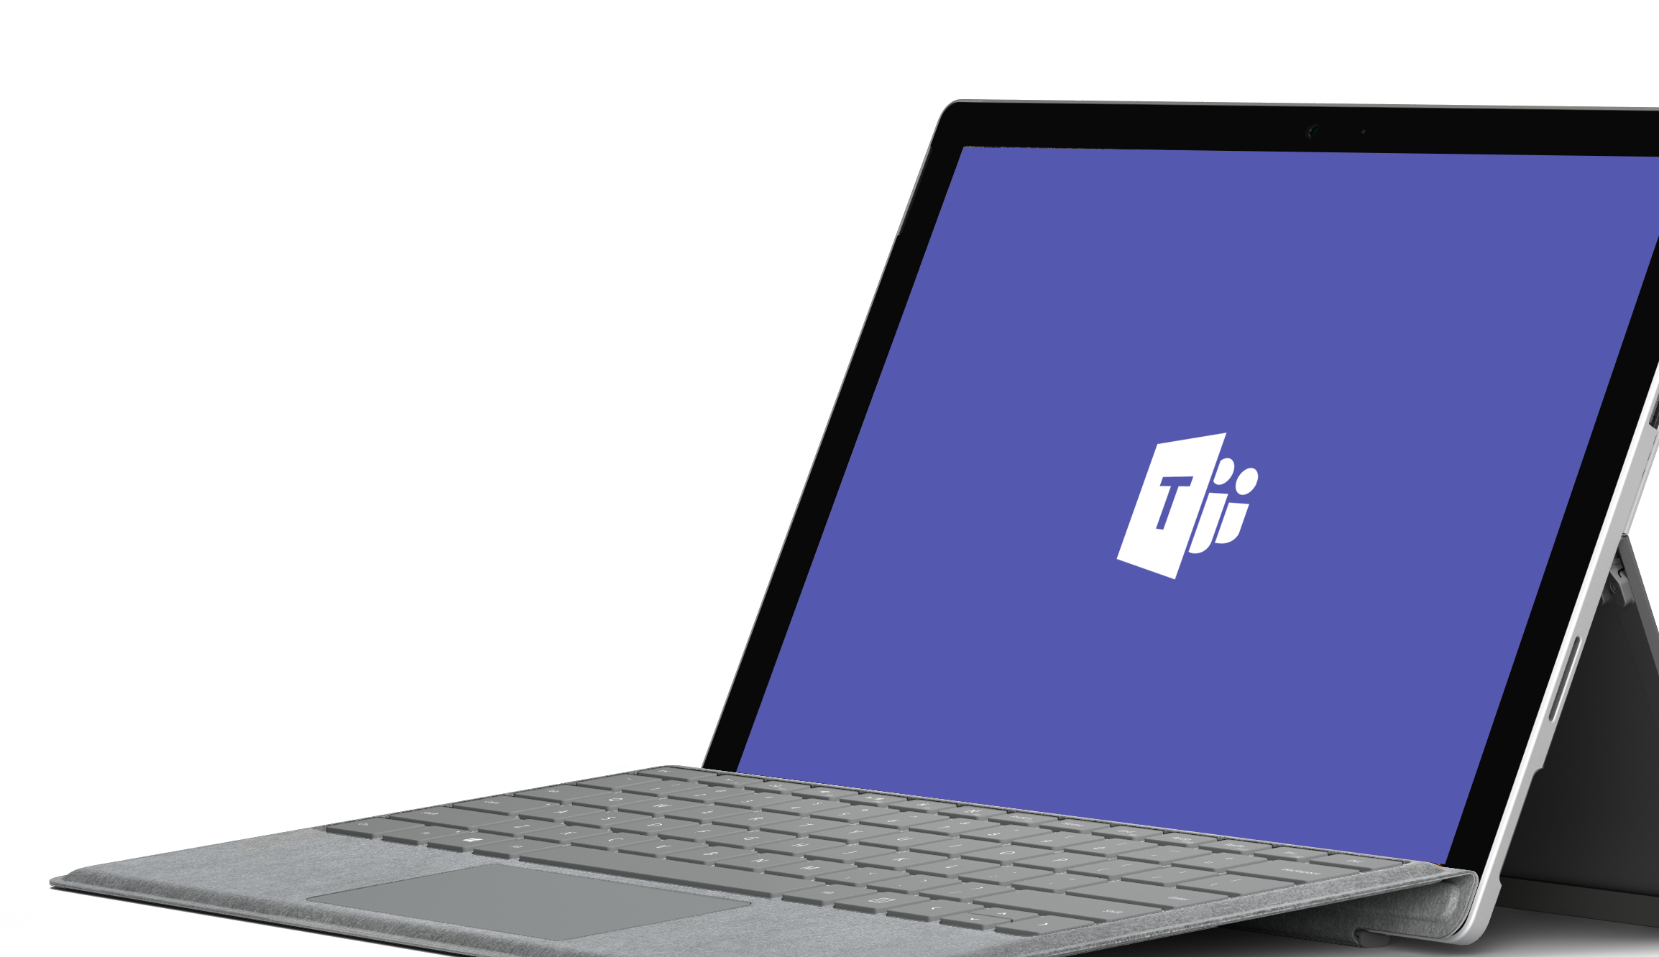
Demo
Notes:
Demos are most effective with customers enabling us to bring the product to life. Please leverage the demo script on Office OnRamp: https://view.officeapps.live.com/op/view.aspx?src=https://demos.microsoft.com/api/download/00000000-0000-0000-0000-000000000000/636551932331784273/Microsoft%20Teams%20Demo%20Guide.docx
As alternative to a live demo, please leverage the PowerPoint Click Through Demo: [new click through will be available mid-December] or the following four slides.
If you demo Teams, you can use the slides to recap the main points of the demo.

Slide 5
Communicate through chat
Communicate without effort and keep your team in the know
Threaded, persistent and contextual chat
Private chats for 1:1 or group conversations
Share information in an open and transparent way
Communicate across geographies
Humanize the workplace – with gifs, stickers, emojis
Notes:
Microsoft Teams provides a shared workspace that enables teams to communicate without effort through chats - across geographical boundaries.
Chats are threaded, persistent and contextual allowing your team to stay in the know and easily understand the context of the conversation.
Today, teams are dynamic. Members, roles, priorities and goals can change, resulting in different communication needs.
[MAIN POINT TO LAND]
In Teams, people can choose how to communicate. They can engage in private 1:1: chats, in group chats or in team conversations that are visible to the entire team. Team conversations are open by default. Working in the open has a transformative effect on the culture of a team and helps organizations move from personal to team productivity.
We have recently added guest access, so you can now chat with everyone on your team, whether they’re inside your organization or an outside partner.
Teams allows you to have fun together. Successful collaboration is based on relationships. So, people can include emojis, memes and fun graphics in messages, which allows them to show their personality, and humanize messages.
Most teams have a fun channel to communicate about other topics than work. For example, when somebody joins the team, or has a baby – you can get to know the people beyond work interactions creating a culture of teamwork.
You can also use gifs, stickers, emojis to bring humor into the communication, and to soften messages. Changing the communication style can change the style of a team. You can worry less about formalities and focus more on the substance.

Slide 6
Collaborate with integrated Office 365 apps
Quick access to the apps you love and are familiar with
Conversations, files and tools in a team workspace
Share, and co-author Office and other files in the app
SharePoint, OneNote, Power BI and Planner integration
Search across people, files and chats
Email integration to keep the whole team in the loop
Notes:
Information often lives across siloed services today – like mail, files, meetings, PowerBI/ data, other SaaS services.
[MAIN POINT TO LAND]
Teams is a hub both for communication and collaboration that brings all these services together in one single workspace. So, teams have one less place to go to resulting in more time for productivity as you do not have to toggle between apps.
All your common tools, all the Office apps that people use every day - Word, Excel, PowerPoint, OneNote, SharePoint, even Power BI - are all built-in, giving people access to the files and tools they need right within Microsoft Teams.
Users can share, co-author and edit Office and other files right in the app. As all files are stored on SharePoint, the latest version of the file is always accessible to any member on the team. This enables organizations to democratize knowledge and give everybody access to the information they need to get their work done.
You can take notes with OneNote or access an integrated calendar from Outlook.
Microsoft Teams is also integrated with SharePoint, PowerBI and planner, so teams can work in a central place with all the necessary tools to pursue team objectives.
We’ve built integration with email, so users can forward an email into a Team’s channel for further discussion.
Microsoft Teams leverages the intelligence of the Microsoft Graph. A team member can access org chart information and do searches for contacts within an organization.

Slide 7
Customize and extend
Tailor your workspace to include the apps and services you need
Pin important files for easy reference in the workspace
Add bots that work on a team’s behalf
Integrate 3rd party services your team uses every day
Build integrations to existing business processes
Manage trusted apps for employees and the organization
Notes:
[MAIN POINT TO LAND]
Every group is unique – both in structure and in style – so we have made it easy for teams to tailor their workspace to their needs and to include apps and services which are relevant to their team or project.
You can set up your channels so that conversations on certain topics happen in designated spaces
You can pin important files for quick reference for the whole team to access them in just one click.
You can add intelligent bots to interact with Microsoft Teams. Bots can answer natural-language questions and perform lightweight tasks such as FAQs.
You can bring in cloud services to explore data and get updates from Microsoft apps and 3rd party apps. Where 3rd party services are included, notifications can be customized so the team never misses a beat.
To bring our users a breadth of customization options, we’re working with more than 150 partners.
We have also created an extensible platform, to enable building apps with a rich set of capabilities to enable higher-performing teams. The Microsoft Teams developer platform enables integrations to your existing business process through publicly available APIs. IT can manage trusted apps for the employees and the organization.

Slide 8
Work with confidence
Get built-in security, compliance and manageability from Office 365
Global hyper-scale cloud, incl. ability for local data residency
Compliance leadership with EUMC, HIPAA & more
Built-in information protection with eDiscovery and audit
Multi-factor authentication and secure guest access
Manage all aspects in a single coherent admin experience
Notes:
Finally, Microsoft Teams provides industry leading security and compliance capabilities and rich management capabilities.
With Microsoft Teams, customers benefit from the Office 365 hyper-scale, enterprise-grade cloud.
[MAIN POINT TO LAND]
From Day 1, the requirement has been for Teams to provide you with the same Office 365 capabilities that you’re used to and to build security, privacy and trust directly into the service.
You can manage and monitor all features in one centralized portal:
Data encryption at all times, at-rest and in-transit.
Customer data at rest remains in region
Ability to have local data residency for core customer data at rest, plus failover and disaster recovery (see data residency slide in the appendix for details)
Human back-up via on-call support engineers standing by 24×7
Customer content is never accessible in logs or telemetry
Multi-factor authentication for enhanced identity protection.
Secure guest access with AAD managed guest accounts
A big privacy topic for all our European customers is of course GDPR – the Global Data Protection Regulation. We will adhere to this ahead of the May 2018 deadline
Microsoft Teams supports key standards including SOC 1, SOC 2, EU Model Clauses, HIPPA, and more. Since preview, we’ve added mobile management with Microsoft Intune and new features for compliance and litigation support, including audit log search, eDiscovery and legal hold for channels, chats and files.
The Microsoft Teams admin center [coming early 2018] provides you with a single coherent admin experience where you can manage all aspects of Microsoft Teams including users, settings, and analytics.
Teams provides enterprise manageability to configure and set policies at a per-user level and manage trusted apps for employees and the organization.
PSTN connectivity in Office 365 will give you the option to connect existing on-premises investments in the future.
Advanced call management controls include call routing, auto attendant, call queues, and reporting.
While security and compliance are critical, our responsibility goes beyond this. Our mission talks about empowering every person to achieve more. With that in mind, we’re focused on building an inclusive experience, including support for those who use screen readers, high contrast, and keyboard-only navigation, to enable the collective brainpower and potential of everyone.

Slide 9

Bringing intelligent communications to life
Microsoft Teams becomes the core communications client
New Skype back-end infrastructure supports voice, video, and meetings
Artificial intelligence will transform the experience for calls and meetings
Notes:
[MAIN POINT TO LAND]
We have recently announced that Microsoft Teams is becoming the core communications client in Office 365.
We’ve started to bring all the capabilities that we've built in Skype into teams to make collaboration even richer and more dynamic, supported by a new Skype back-end infrastructure.
And we’re harnessing the power of artificial intelligence and cognitive services to transform your calls and meetings experience and to bring our vision of intelligent communications to life.

Slide 10



Intelligent communications for calls and meetings
Before
Insights, history, and deeper context
During
Everyone connected
After
Notes and action items automatically captured
Notes:
Envision what intelligent communications can do, starting with a call.
What if, before a call, technology could help you prepare by giving you insights about the people you’re talking to and the projects you’re talking about?
What if, during the call, technology could help connect everyone—accounting for diverse languages, visual and hearing impairments, and even help alleviate a noisy environment?
What if, after a call, technology could do the heavy lifting of sending out notes and action items?
[For deeper discussions, please use the Intelligent Communications deck: https://microsoft.sharepoint.com/sites/infopedia/pages/layouts/kcdoc.aspx?k=G03KC-1-9219]

Slide 11
Communicate through meetings
More effective, real-time conversations
Join online meetings with HD video, VoIP, and dial-in audio conferencing options
Available for mobile, desktop, browser and certified devices
One-touch join with Skype Room Systems
Support for Surface Hub and existing rooms
Intelligent meetings
Meeting recommendations based on attendee availability
Related files and chat history at your fingertips
Cloud recording of meetings with transcription and translation, indexed for searching
Notes:
Let’s take a closer look at meetings….
Already today, Microsoft Teams offers a complete meeting solution supporting sharing, video and audio conferencing.
You can use Teams for informal 1:1 or group chats. Teams supports scheduling and free/busy calendar availability information.
Teams is available across mobile, desktop and browser and integrated with communications and meeting room devices, providing a frictionless experience no matter which device users work from.
[MAIN POINT TO LAND]
Tapping into the cognitive services of Office 365 and the power of Microsoft Graph we will bring intelligence to calls and meetings. This will change the very nature of calling and meeting experiences and enable an organization to transform an ordinary meeting into a modern meeting:
Already today, Teams provides meeting recommendations based on attendee availability. Team members can share and review information and conversation history to have contextual and informed meetings
After a meeting, team members can access recordings with transcribed and translated text that is indexed so that people can search for content relevant for them.

Slide 12
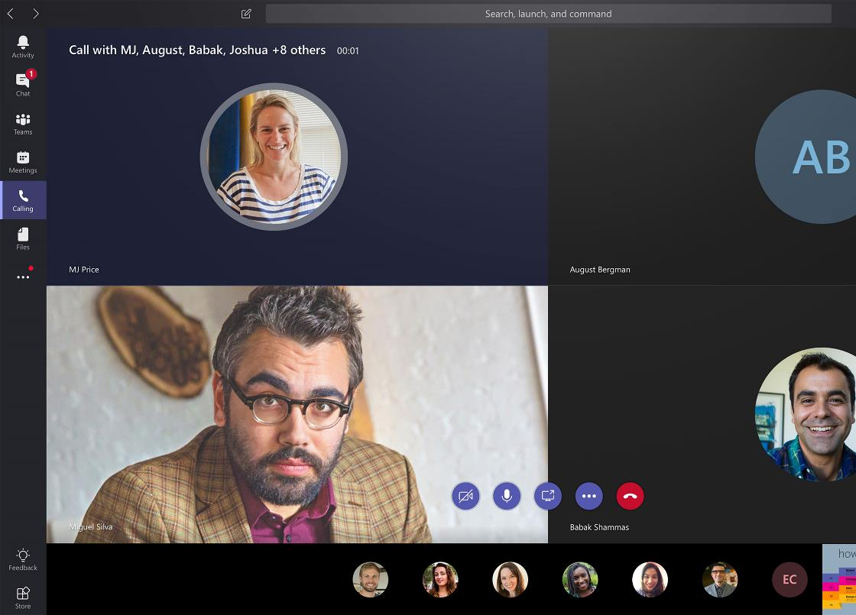
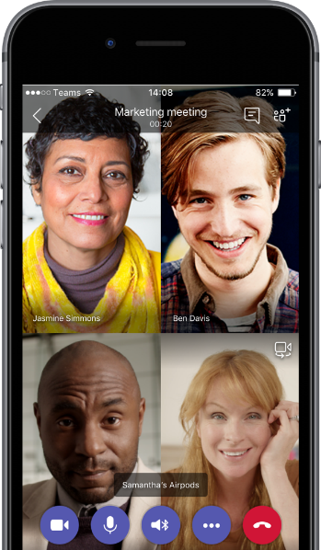
Communicate through calling
Connect with anyone through Phone System and Calling Plans
Have a dedicated phone number for domestic and international calls
Advanced features including voicemail, transfer and emergency calling (e911)
Advanced call management including. call routing, auto attendant and reporting
Future support for hybrid voice using on-premises PSTN connectivity
Notes:
[MAIN POINT TO LAND]
Microsoft Teams also offers a reliable, cloud-based telephony plus calling solution that allows you to connect with anybody. This can enable you to save cost, reduce hardware dependencies, and leverage the power of the Microsoft Cloud.
The base for calling (telephony) is the Microsoft Phone System which is a fully integrated, software-based PBX in Microsoft Teams. It allows you to have enterprise phone features for all Office 365 users in your organization and manage their telephony completely in the cloud.
Microsoft customers can then choose 3 different approaches to have dial-tone added to their Microsoft Phone System deployment.
We offer the Microsoft Calling Plan which allows users to have a dedicated phone number for placing and receiving domestic and international calls. Currently we service 8 countries and we continue to add new countries. In this model, Microsoft is your dial plan provider. The value to you is that you have one provider for calling – less vendors means less points of failure and one vendor to resolve issues.
Customers can alternatively choose to use their local Telco provider for dial tone and connect those “trunks” to Microsoft. This exists today for Skype for Business Online and we anticipate this to become available in the middle of CY2018 for Microsoft Teams.
And for customers with offices located in many geographies, we expect and will support a mix of Microsoft Calling Plan usage and Telco provided dial tone, typically based upon user location.

Slide 13
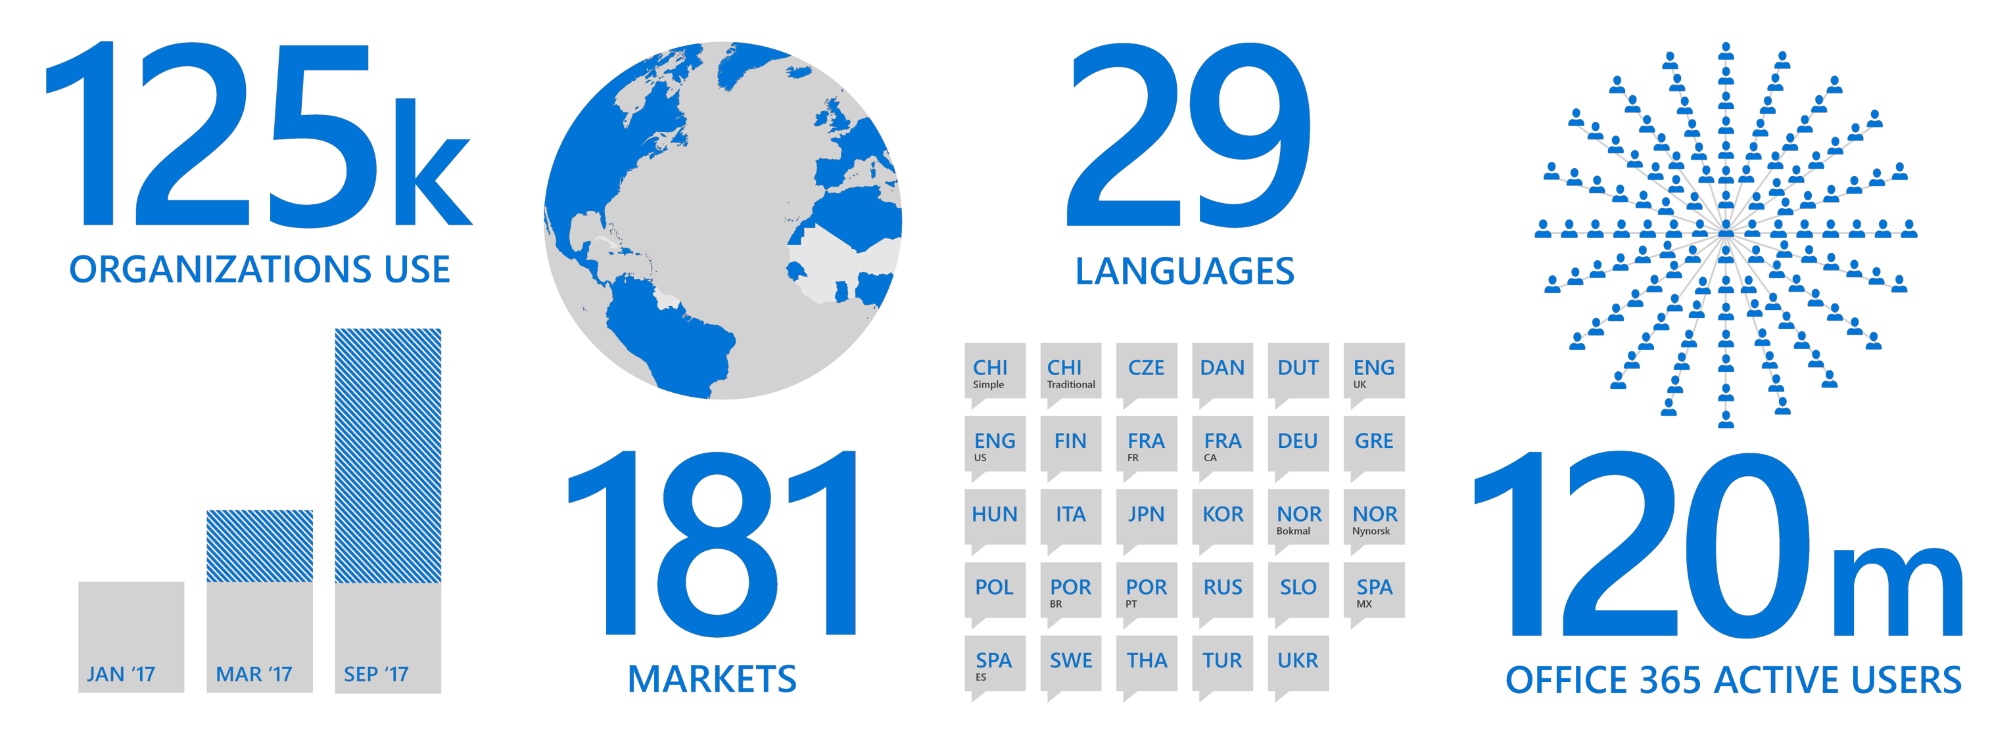
Microsoft Teams – enabling global teamwork
200k
39
ORGANIZATIONS USE
LANGUAGES
BUL
CAT
CHI
Simple
CHI
Traditional
CZE
DAN
DUT
ENG
UK
ENG
US
EST
FIN
FRA
CA
FRA
FR
DEU
181
GRE
HUN
IND
ITA
LIT
JPN
KOR
120m
NOR
Bokmal
NOR
Nynorsk
POL
POR
BR
POR
PT
RUM
RUS
MAR ‘17
SEP ‘17
MAR ‘18
SCR
SLO
SLV
SPA
MX
SPA
ES
SWE
THA
MARKETS
TUR
UKR
VIE
WEL
OFFICE 365 ACTIVE USERS
Notes:
Since the GA moment in March 2017, Microsoft Teams has been enabling teamwork worldwide and is now used by 125k of our customers.
Microsoft Teams is enterprise ready. It is supported in 29 languages across 181 markets and allows you to store your data in 6 datacenters worldwide.
It allows people worldwide - Office 365 commercial has 120M active users - to use the Office apps they are familiar with and they love.

Slide 14




What we hear from our customers
Enables new ways of working
“Microsoft Teams gives us the ability to mobilize people in a way we’ve never seen before.”
Jamie McLellan, Chief Technology Officer, J. Walter Thompson
Accelerates decision making
“Through Microsoft Teams and SharePoint Online to compare results in almost real time and build a faster car.”
L.Bryce Whitson Jr., Aerodynamics Engineer, Hendrick Motorsports
Drives digital transformation
“Pulling data from Power BI automatically from each group and combine it into one view in Microsoft Teams is a lot more efficient than our previous process.”
Sunil Yadav, President, Amplifi Asia Pacific, Dentsu Aegis
Notes:
How does Microsoft Teams benefit our customers?
What we hear from our customers:
Microsoft Teams helps them to enable new ways or working. It helps teams to be more collaborative, work in the open with everybody in the know, democratizing information and decision making.
It helps them to accelerate decision making. In Microsoft Teams, information is shared in the moment and with context, enabling people to quickly make an informed decision.
Microsoft Teams is also a driver of digital transformation by helping our customers to modernize business processes and align them with how people work in the modern workplace.
Case study: https://customers.microsoft.com/en-us/story/jwt-professional-services-microsoft-teams
Video: https://www.youtube.com/watch?v=oZrynUTuyf0&feature=youtu.be

Slide 15
Teams for different departments
Marketing
Deliver marketing campaigns and go-to-market activities across a diverse group of internal and external stakeholders.
Sales
Build and deliver proposals with input from different stakeholders.
Manage sales planning, training and sales readiness in the same place.
Finance
Aggregate and report on data while conducting business reviews
Human Resources
Manage recruitment, training and reviews across departments.
IT
Drive IT transformation and change management.
Plan, execute and manage all phases of IT deployment, adoption and rollout.
Engineering
Move quickly between ideation, development and deployment.
Integrate with developer tools.
Project Management
Manage project stakeholders, tools, budgets, project reviews and feedback.
Get guidance on these and other scenarios in the FastTrack Productivity Library
Notes:
How do different departments use Teams?
Marketing teams can manage go-to-market, public relations, event planning and their budget within Teams. They can add guests e.g. agencies with secure guest access. They can connect relevant third-party services to each channel, such as Bing News Alerts, Twitter Connector, Adobe Creative Cloud, HootSuite and YouTube.
Sales teams can manage sales planning, RFP/Proposals. Teams provides a single place where all this collaboration, reporting and knowledge sharing can happen. They can set up monthly business reviews as meetings in Teams. Document sharing e.g. sales playbooks can be done from within Teams. They can also use apps like PowerBI, Planner or even task management apps like Trello.
Finance teams can conduct their finance reviews within Teams and also share content around, business insights, audits, and compliance. Teams provides a hub in which all files, data, conversations and meetings can happen in a single place, safely and securely. They can easily share files like annual financial statement review or audit report and use apps like Excel, PowerBI, Planner or even pin critical files, internal or external websites to a tab
HR teams can manage their recruitment, training, events, and reviews from within Teams. Teams provides a single hub where HR professionals can collaborate, plan, share notes and communicate decisions. They can upload files to the channels e.g. HR policies, candidate information, offers extended, training or recruitment guidance notes, internal websites, feedback forms and surveys. Use a shared One Note or Wiki for candidate feedback. They can use Teams for training calls in Teams and do post training surveys on third party apps like Survey Monkey.
IT can leverage Teams a hub for service strategy, problem, incident and change, deployment, health and reporting, readiness and adoption, support and management and governance. They can set up connectors e.g. bots for process automation.
Engineering teams can leverage Teams for go-to-market, feature releases, testing, feedback, competitive information, research and product analytics. They can set up connectors or tabs for VSTS, JIRA, BitBucket and GitHub or leverage developer tools like Botkit. Teams enables continuous discussion across a distributed team and is integrated with developer tools.
Project teams can leverage teams for planning, budget, analytics, reviews and feedback. They can use apps like Planner, PowerBI or set up connectors e.g. bots for process automation. Teams enables collaboration in one central hub with all the tools needed to manage a project.

Slide 16
Where to Start a Conversation
Yammer
Teams
Outlook
Email
Inner Loop
Outer Loop
People you work with regularly on core projects
Files
Sites
Content
SharePoint
People you connect with openly across the organization
Ubiquitous for targeted communications
Office 365 Groups
Cross application group membership
Notes:
[Please only use this slide if your customer has questions on the right tool to use when. Objective of this slide is to reinforce our teamwork position]
Microsoft 365 meets the diverse needs of teams with an integrated solution that is secure
We’ve designed Microsoft 365 to meet the unique needs of every group.
For each of those categories of teamwork, Microsoft 365 includes a purpose-built application.
When deciding how best to leverage our toolkit for your team needs, think about the type of work that needs to get done and the type of conversations your team needs to have.
The inner loop includes people you work with regularly, actively communicating and working on projects to deliver against important goals and deliverables. For this type of interaction Microsoft Teams is the best tool, allowing you to actively engage with your team in a shared work space where you can work on files, chat, and even host meetings.
Your outer loop includes people across your company who provide valuable information, that you openly connect with on common topics of interest. Yammer is the best tool for your outer loop, letting you openly connect across the company to solicit ideas, and share best practices on broader initiatives.
Outlook remains a tried and true tool for conversations, and is useful for teams that want to quickly share and communicate in a familiar place
Of course, content and creativity is at the center of every team – the very reason teams come together to connect, whether it is collaboration on a new product strategy, a sales presentation or a key company initiative. SharePoint is the tool that keeps content at the center of teamwork, making files, sites and content easily shareable and accessible across teams and organizations. SharePoint is tightly integrated with Teams, Yammer and Outlook in order to enable seamless content collaboration across conversation experiences.
And it’s all built on an intelligent fabric - suite-wide membership service with O365 Groups; suite-wide security and compliance; suite-wide discovery and intelligence based on MS Graph

Slide 17

Next steps
Get started Start using Microsoft Teams today
Pick one project
Do all collaboration on that project in Teams
Download the mobile app
Get support Get deployment & adoption support from
FastTrack
https://aka.ms/SuccessWithTeams
Provide feedback Give us feedback directly in the product
Notes:
When you follow up with the customer, here are additional resources to point them to:
Practical Guide to the Modern workplace: https://resources.office.com/ww-landing-M365E-Practical-Guide-to-the-Modern-Workplace-WhitePaper.html?LCID=EN-US

Slide 19
How to use this deck
New or existing Office 365 customers
Use this deck for an initial conversation about Microsoft Teams.
If your customer is using or considering a compete solution (i.e. Slack, WhatsApp), please use the compete resources on Office OnRamp to inform yourself on how we differentiate.
The appendix includes deep dive and customer evidence slides.
Unified Communications customer
Leverage the Intelligent Communications vision deck.

Slide 20
Appendix

Slide 21
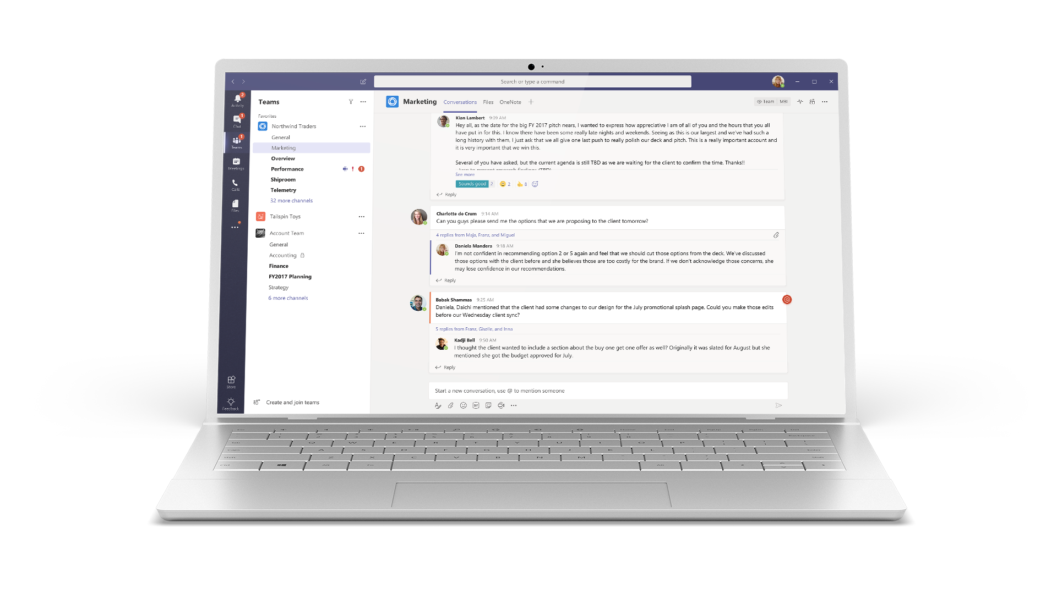




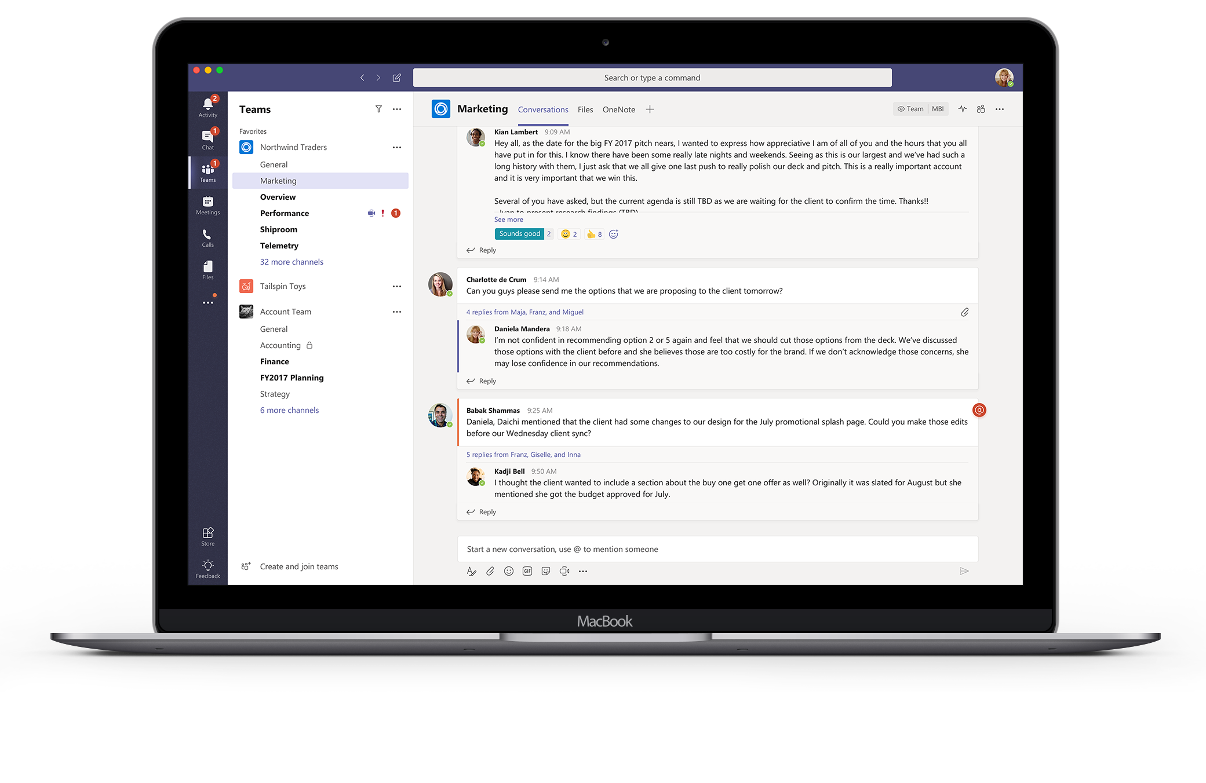


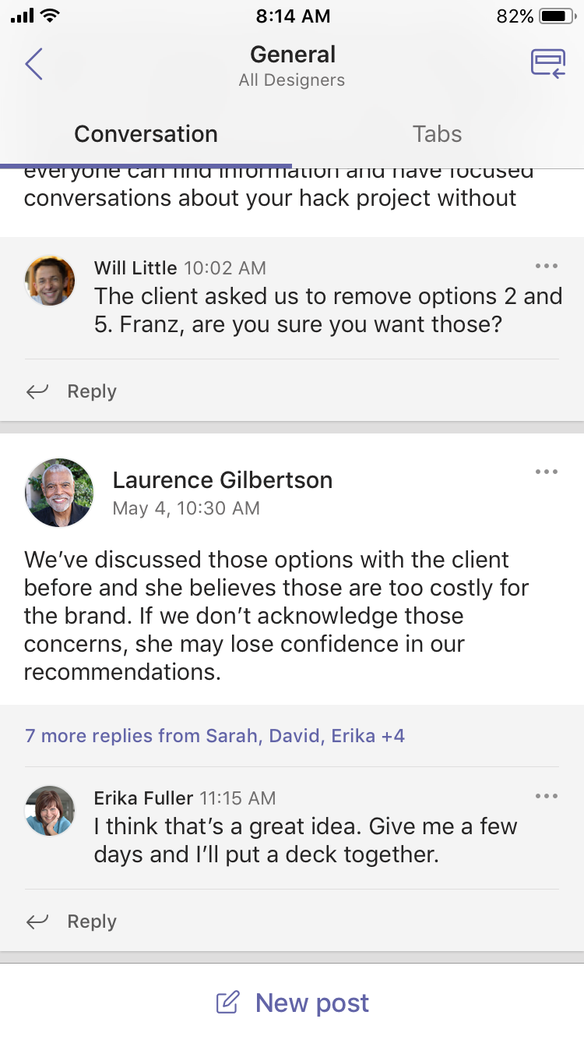
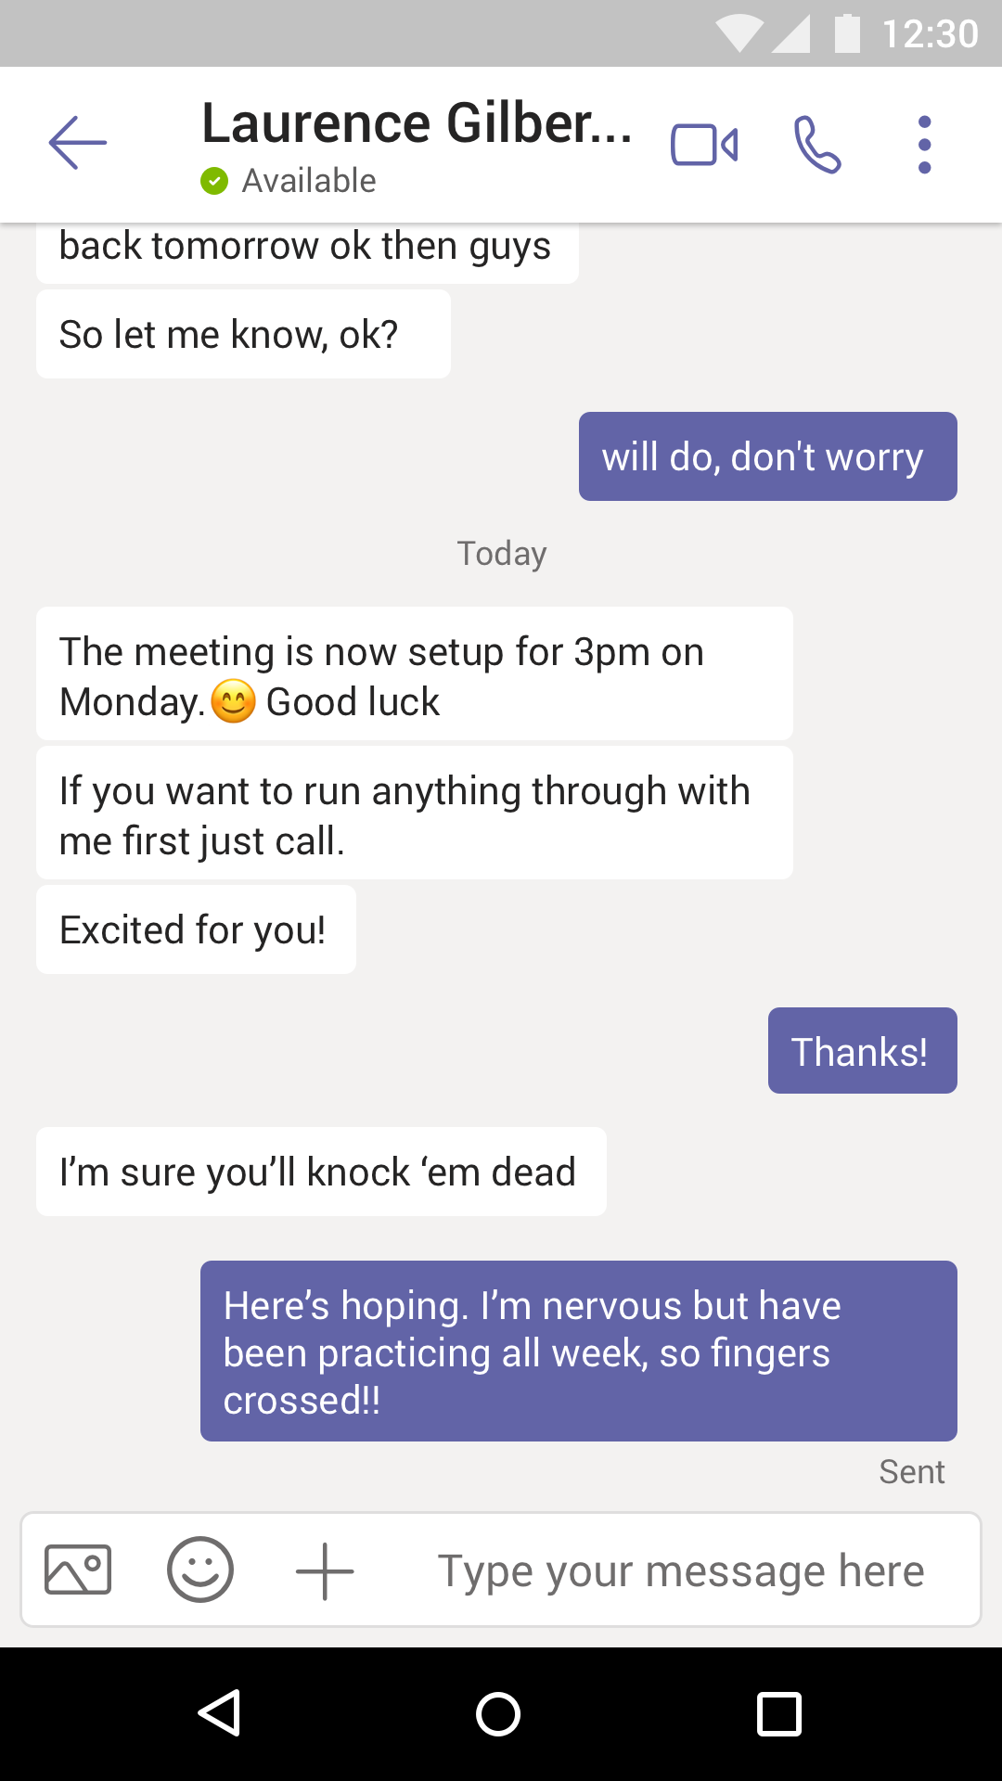



Cross platform presence
Desktop
Mobile
Browsers
Windows 7+
iPad
Edge
Chrome
Firefox
OS X 10.10+
iPhone
Android
Notes:
Finally, Microsoft Teams provides industry leading security and compliance capabilities and rich management capabilities.
With Microsoft Teams, customers benefit from the Office 365 hyper-scale, enterprise-grade cloud.
[MAIN POINT TO LAND]
From Day 1, the requirement has been for Teams to provide you with the same Office 365 capabilities that you’re used to and to build security, privacy and trust directly into the service.
You can manage and monitor all features in one centralized portal:
Data encryption at all times, at-rest and in-transit.
Customer data at rest remains in region
Ability to have local data residency for core customer data at rest, plus failover and disaster recovery (see data residency slide in the appendix for details)
Human back-up via on-call support engineers standing by 24×7
Customer content is never accessible in logs or telemetry
Multi-factor authentication for enhanced identity protection.
Secure guest access with AAD managed guest accounts
A big privacy topic for all our European customers is of course GDPR – the Global Data Protection Regulation. We will adhere to this ahead of the May 2018 deadline
Microsoft Teams supports key standards including SOC 1, SOC 2, EU Model Clauses, HIPPA, and more. Since preview, we’ve added mobile management with Microsoft Intune and new features for compliance and litigation support, including audit log search, eDiscovery and legal hold for channels, chats and files.
The Microsoft Teams admin center [coming early 2018] provides you with a single coherent admin experience where you can manage all aspects of Microsoft Teams including users, settings, and analytics.
Teams provides enterprise manageability to configure and set policies at a per-user level and manage trusted apps for employees and the organization.
PSTN connectivity in Office 365 will give you the option to connect existing on-premises investments in the future.
Advanced call management controls include call routing, auto attendant, call queues, and reporting.
While security and compliance are critical, our responsibility goes beyond this. Our mission talks about empowering every person to achieve more. With that in mind, we’re focused on building an inclusive experience, including support for those who use screen readers, high contrast, and keyboard-only navigation, to enable the collective brainpower and potential of everyone.

Slide 22

Providing clarity and consistency for the protection of personal data
The General Data Protection Regulation (GDPR) imposes new rules on organizations that offer goods and services to people in the European Union (EU), or that collect and analyze data tied to EU residents, no matter where they are located.
Enhanced personal privacy rights
Increased duty for protecting data
Mandatory breach reporting
Significant penalties for non-compliance
Microsoft believes the GDPR is an important step forward for clarifying and enabling individual privacy rights
http://www.microsoft.com/GDPR
Notes:
Please view presenter notes/talk track at: aka.ms/gdprnotes
View the Microsoft external site for more information: www.Microsoft.com/GDPR

Slide 23
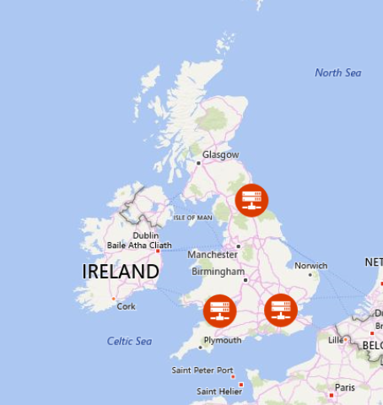
Data Residency
181 countries | 29 languages
Chat data stored ‘In Region’ based on tenant affinity
If tenant in Australia, Canada, India, Japan, the UK, or the United States Files are stored ‘In Country’ (SPO)
Teams honors EU model clauses
Teams has now added UK as an datacenter location: Cardiff + London
EMEA
APAC
AMERICAS
Dublin
UK
Bay
Amsterdam
Des Moines
Hong Kong
Teams Data in UK
Singapore
Notes:
Teams is available in 181 countries and in 29 languages. To achieve this we are currently deployed in three regions around the world, this includes the Americas, EMEA, and APAC. Your chat data at rest is stored and stays in region based on tenant affinity. So if you sign your subscription for O365 in a country like France you can be assured that your data at rest stays in EMEA and falls under the laws of the EU.
For files, we go a step further. Files in Teams are actually stored in country for Australia Canada, India, Japan and the United states. We also honor the EU model clauses.
Looking forward we are expanding our footprint for data residency. We’re now supporting chat data ‘In Country’ for the UK and we’re working on supporting India, Australia, Japan and Canada in 2018.
We are also working on making Teams available in the US Gov clouds in 2018.

Slide 24
Implementation Phases
For Office 365 and Microsoft Teams
1
2
3
4
5
Gather your team
Stakeholders, Champions & Early Adopters
Prioritize business scenarios
Completed technical planning
Network, security, mobile support & deployment
Complete pilots and broad onboarding
Measure, manage & drive adoption
Envision
Onboard
Drive Value
Continuous Adoption & Success Measurement
Notes:
Microsoft Teams and Office 365 share common planning, deployment and adoption best practices as described on this slide. Get more insights by downloading the Microsoft Teams Quick Start and Planning Guide [link coming in January]
Step One: Get your people together
Assemble a group of individuals from business, IT and the user community to act as the stakeholder & decision making group for your Teams deployment. In smaller organizations this may be 2 or 3 people. It is essential for success to include business/users AND IT professionals together for this journey.
Step Two: Prioritize your business scenarios
Enabling collaboration and communication is about people! Prioritize your work using relevant business scenarios that will resonate with your users instead of talking about features & functions. Check out the FastTrack Productivity Library for examples and define specific scenarios for your company.
Step Three: Complete Technical Planning
Good deployments are based on efficient technical planning. If your organization is over 50 seats and participating in an eligible plan you can utilize FastTrack services to guide you in this phase. Or, you can complete this yourself using our FastTrack Onboarding Wizards which are available from the main FastTrack portal once you have signed in with your Office 365 account. Additional information for completing this step for Microsoft Teams can be found here. At a minimum you will want to review these three articles:
Check your environment's readiness for Microsoft Teams
Prepare your network for Microsoft Teams and
Office 365 URL's and IP address ranges
In addition, certain organizations may want to review the security and compliance overview for Microsoft Teams
Use the following additional sections of this document to complete your technical planning for Microsoft Teams.
Step Four: Complete pilots and broad deployment
In most organizations you will want to conduct and initial pilot with your stakeholders, champions and select early adopters for a given scenario. This will gain you valuable information about how Office 365 and Microsoft Teams are received in your organization. Once that is complete and feedback received you can plan your broad deployment. Many large organizations will conduct that in phases to manage the onboarding and training work required to implement a quality employee experience. What is most important is that you integrate your prioritized business scenarios with your deployment planning to ensure your employees are getting the most from Office 365 and Microsoft Teams.
In smaller organizations (currently less than 2500 users) we often suggest enabling Microsoft Teams for the entire organization and adding all users to a main team for the complete company. Configuring this team with common reference items and tasks can simplify the collaboration and productivity experience for your employees.
As you conduct this deployment do not forget about the power of the mobile experience! Enabling your users to utilize Office 365 mobile applications can dramatically increase usage and satisfaction with the tools. Office, Outlook, SharePoint, Microsoft Teams, Planner, Yammer and other popular parts of Office 365 all have mobile experiences for popular operating systems like iOS and Android. It is our best practice to enable access to these mobile applications at the same time you deploy the desktop and browser versions of the applications.
Step Five: Measure usage, manage satisfaction and drive adoption
Deploying software is not all that is required in driving change in your organization. Remember, empowering collaboration is about people not technology. To successfully drive adoption of Office 365 and Microsoft Teams you must stay focused on the experience of your employees. Here is a quick checklist of our best practices guidance to get you started. Microsoft Partners can also assist you in designing an adoption plan that is right for your organization.
a. Review the Office 365 Adoption Guidance document for broad best practices.
b. Review Office 365 usage reporting to understand usage across your environment. If you are not an Office 365 Administrator for your company ask your administrator to grant you Report Reader role so you can access them.
c. Capture feedback from your employees on their experience of Office 365 and Microsoft Teams. Utilize a public channel in Microsoft Teams when your organization is less than 2500 individuals. Use a public group in Yammer when your organization is larger than this current membership limit in Microsoft Teams.
d. Use Your Digital Day materials to Drive use of common features by encouraging chat, @mentions and usage of cloud storage (OneDrive & SharePoint Online via Microsoft Teams) to draw people into the experience. Stop emailing that spreadsheet around!
e. Nurture your champions and highlight your wins. Reward employees for embracing these new tools and using them in innovative ways that relate to business outcomes for your company. This above all other things will ensure continued adoption of Office 365 and Microsoft Teams.

Slide 25
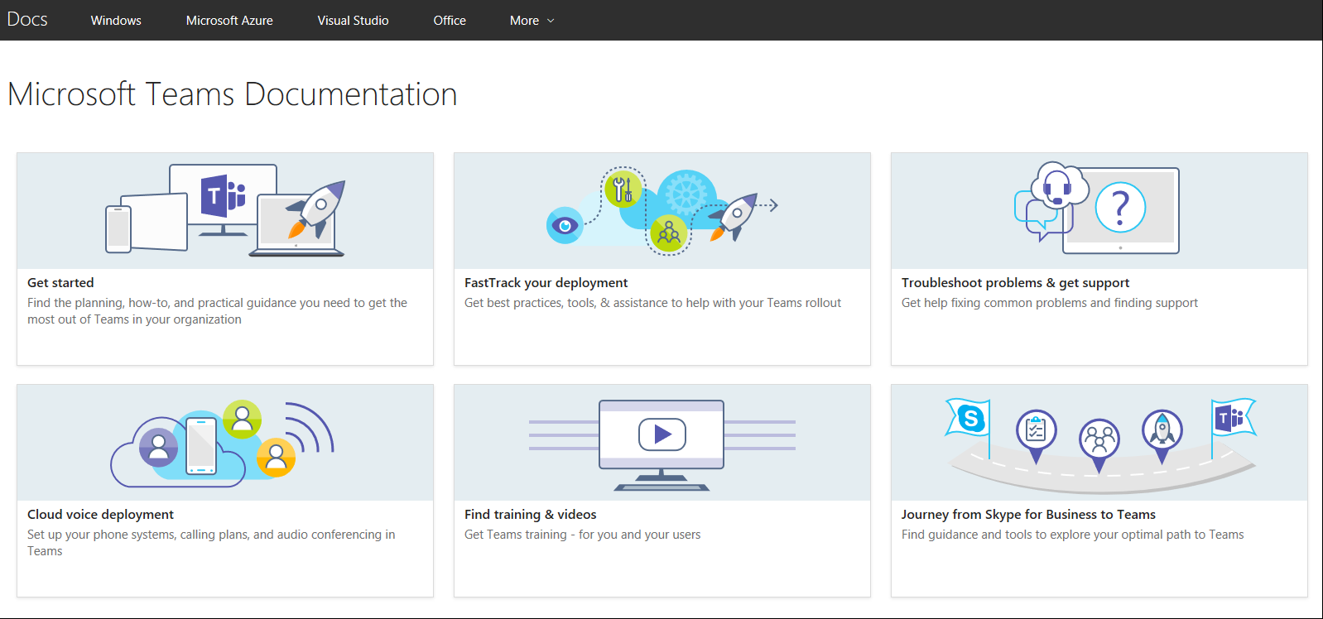
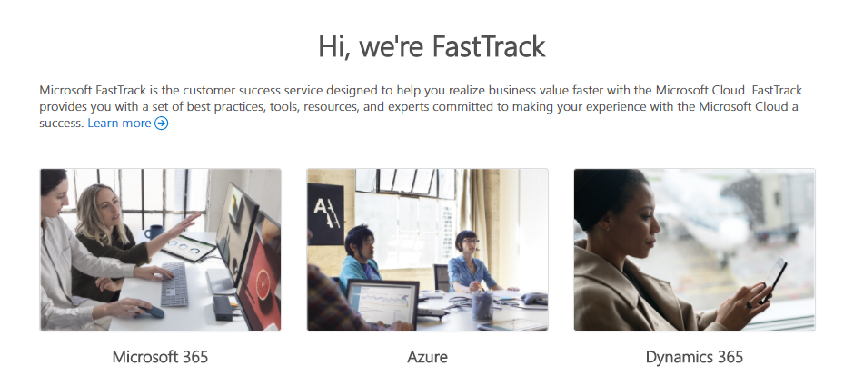
Resources to Learn More
https://aka.ms/SuccessWithTeams
https://FastTrack.microsoft.com
Your hub for all things Microsoft Teams including vision, practical onboarding guidance, success stories, help and support.
Assistance for customers to realize their vision with Microsoft cloud services
Resources
Office Blog https://aka.ms/OfficeBlog https://aka.ms/TeamsOfficeBlog
Office Roadmap https://aka.ms/OfficeRoadmap
Product Help https://aka.ms/TeamsSupport
Known Issues List https://aka.ms/TeamsKnownIssues

Slide 26
Teams Architecture: bringing together Office 365 and Skype
Teams Clients
Office 365 platform and services
Teams Services
Skype Infrastructure
Azure
Notes:
From an architecture perspective, Teams brings together Office 365 and Skype, so Teams sits between Office 365, Skype and on top of Azure.
The services that we built inside Teams, the services that our Teams engineering team owns and operates, they are really an orchestration layer that brings the other pieces together and then to do things like attach a modern group to a set of chats. Or to make sure a SharePoint side is provisioned when you create a Team.
And we build all of that on, the same scalable Azure infrastructure that any of you can use.
Then of course on top, we have a series of clients – we’ll go into more details in a few minutes. These clients are not just built on top of a Teams API or the Teams layer. In many cases, it was more efficient to let the clients talk directly to the other services so they go across all three.

Slide 27
Teams Conversations Logical Architecture
Chat
Modern Group
Team
SharePoint Team Site
Folder
Channel
OneDrive
Images
Tabs
Message
Reply Chain
Notes:
Any of you who know Office 365 and Teams, you know that we’re still missing a lot of pieces. So let’s take a closer look. What happens when you have a conversation in Teams.
It starts with you. That orange person in the middle of the screen. When you create a team, as part of provisioning the team, we create a modern group. Teams is built on top of groups.
And you as the owner or also if you get added to the team, then you become part of that group.
We also provision a SharePoint site for each team where you can share files.
So, every team has a modern group, and every team has a SP site.
Then, each team consists of a set of channels that you can have discussions in. And each channel has its own mapping into a folder on the SP site so that you can share files within the channel using SharePoint.
Each channel also has a set of tabs. If I want to include an excel file or word or PowerBI or Trello directly into the channel, you can do that by including it via a tab.
One of the differentiators of Teams is that conversations are threaded. So we have built-in reply chains in all the channels. each channel has a set of reply chains or threads. And each chain has a set of messages and those messages can have images. We'll talk about where all of these things are stored. Right now, this is the logical architecture behind it.
As a user, I don't have to stick to my team/ to my tribe, I can go across the company and have 1:1 chats or group chats with anyone. And in the chat, I can also share files and we use ODfB for that, and you of course also have messages and you can share images.
This is the logical architecture behind Teams. This is how we thought about it before building the services.
This only covers conversations, this doesn’t include meetings and calling and some of the other features like bots.

Slide 28






Teams developer opportunity
Tabs
Bots
Microsoft Teams provides a powerful and extensible platform
Build apps with a rich set of capabilities to each your users through chat, channels, notifications and personal workspace.
Integrate with new or existing business processes and services
Surface rich content within Teams
Help users get tasks done in conversations
Compose Extensions*
Connectors
Allow users to query and share rich cards in conversations
Post rich updates to channels
Actionable Messaging*
Activity Feed*
Add rich interaction to your connector cards
Engage users via feed notifications
Microsoft Graph**
Learn more: https://developer.Microsoft.com/Microsoft-Teams
Build in intelligence and connect to data that drives productivity
*Feature in Developer Preview, **APIs in beta
Notes:
Microsoft Teams has an open developer platform with a rich set of capabilities to build apps or integrate with new or existing business processes and services.
Tabs allow you to surface rich content within Teams, so you can bring the tools and services your team cares about right into a channel or private chat. Add rich dashboards and data visualization, collaborate on documents and note taking, manage tasks across the group, share designs.
Bots help users get tasks done in conversation in Teams. Bots can do things like kick off workflows and provide status on them, give and receive kudos from team members, create lightweight surveys to gauge employee satisfaction, and answer natural language questions about sales and customer usage data.
Connectors help bring useful information and rich content from external services into channels in Microsoft Teams. Get social media notifications, updates about pull and push requests, news updates.
With Actionable messages, you can add rich content to your connector cards.
Compose extensions allow users to query and share rich cards in conversations.
Activity feed notifications engage users via feed notifications.
To learn more about the Teams developer platform, visit the Office Dev Center at Developer.Microsoft.com/Microsoft-Teams.

Slide 29

Transition to Teams
Enable with transparency and communication
Upgrade when Teams meets your organization’s needs
Empower IT to control and manage process
Ease user transition with in-product features
Support through partner and device ecosystem
Notes:
Transition to Teams
Ensure transparency. Keep everyone up-to-date on why the change is happening, what the implications are, and how the change will occur. Start with our roadmap, published in October.
Upgrade when Teams meets your organization’s needs. Stay up-to-date with the Office 365 roadmap, and use this information to help plan your transition. This is a new paradigm—instead of working back from an end-of-life date, look forward and move to Teams as soon as it meets your business needs.
Empower IT to control and manage the process. Control how Teams is rolled out in your organization—to a subset of users or the whole organization, standalone or side by side with Skype for Business. [See Appendix] With Teams, you’ll have the same tools you use today—like the Call Quality Dashboard and Call Analytics—to manage your environments.
Ease user transition with in-product features and help. Help end users by providing first-run experiences for Skype for Business users in Teams. Take advantage of T-Bot, which will continue to learn as more users onboard, to help with troubleshooting and how-tos.
Get support through a partner and device ecosystem. In addition to the roadmap, we’re sharing guidance with our partners to ensure they can help you through your transition. We’re working with our device partners to help them onboard to Teams and bring forward investment in areas like Skype Room Systems and Polycom’s Group Series.

Slide 30
Device Portfolio Landscape
Meeting Workspace
Personal Workspace
Mobile Workspace
50-60% of mtg participants
Content & increasingly video centric
10 – 20% of mtg participants
Audio Centric
10 – 20% of mtg participants
Audio Centric
Spaces
Room Systems
Meeting audio & video
Interactive content canvas
Bluetooth & USB headsets
Webcams
Speaker “pucks”
Bluetooth Headsets
Form Factor
Notes:
Meeting workspace first, then mobile then personal. Put box around mobile & personal- we treat these as 2

Slide 31
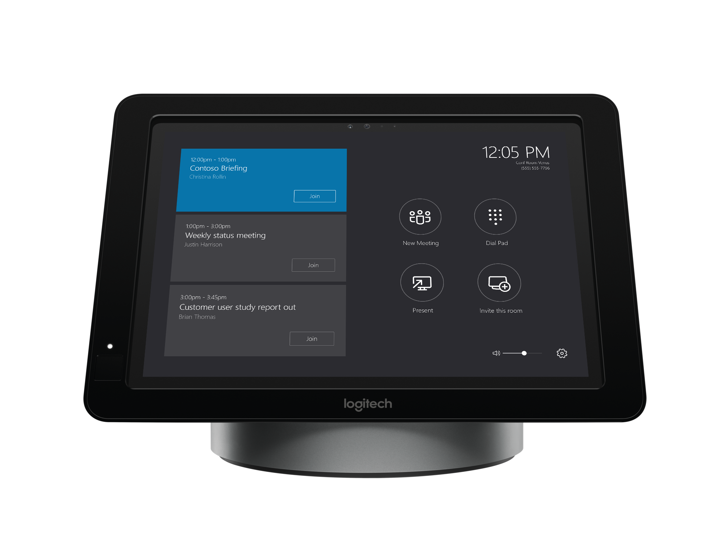
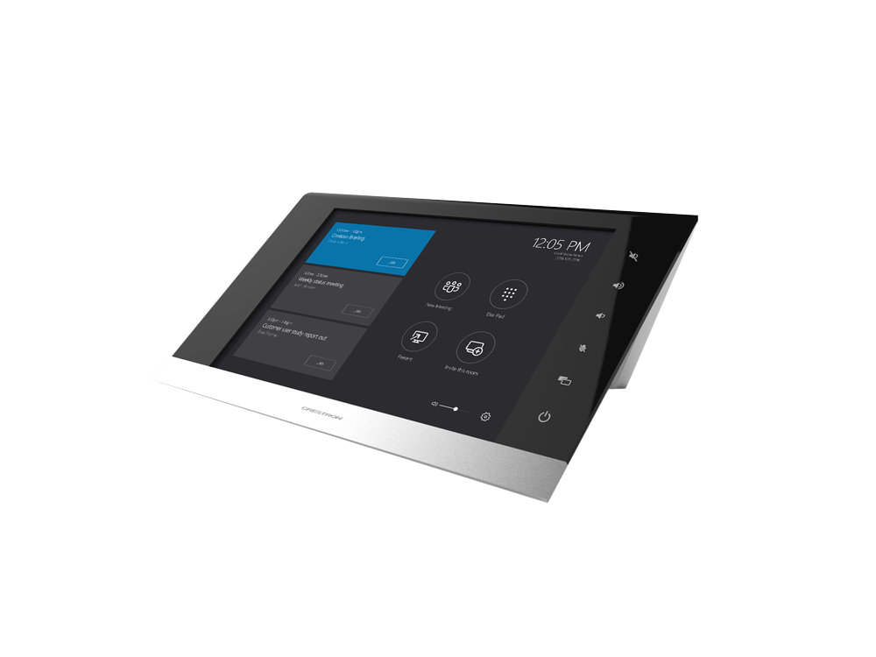



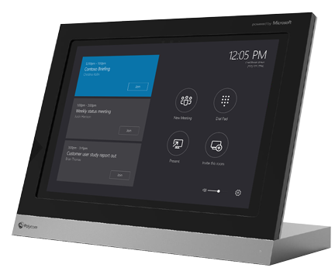
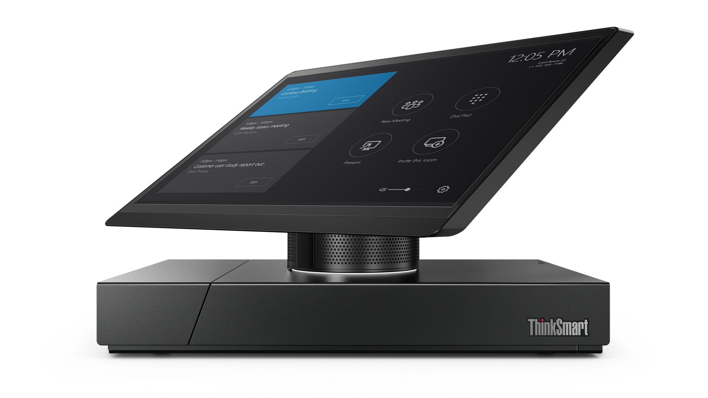



Meeting Room Solutions…
Skype Room Systems
Video interop for existing devices
Available now
Available now
NEW!
Available for SfBO Coming to SfBS & Teams
Available for SfBS Coming to Teams
Coming to Teams
Available now
Coming in early 2018
Notes:
We introduced Skype Room Systems in late 2016, and we’re seeing strong momentum with these devices from customers because they want the simplicity of single-click join. Logitech and Crestron devices are available today. Polycom devices are available for pre-order, and Lenovo is bringing a non–Surface based device to market in early 2018. More partner news is on the way. [Under NDA, HP will also have a device in 2018.]
All Skype Room Systems will be upgraded to support Teams meetings with capabilities that are similar to Skype for Business meeting capabilities.
We also want to enable existing meeting-room devices to provide Team meeting experiences, and we’ll support this with cloud video interoperability in the future. Polycom’s RealConnect for Office 365 is currently available for Skype for Business Online. It will be available in the future for Skype for Business and Teams. Pexip is available today for Skype for Business Server and will be available for Teams in the future. BlueJeans Network will bring a new service to Teams as well.

Slide 32

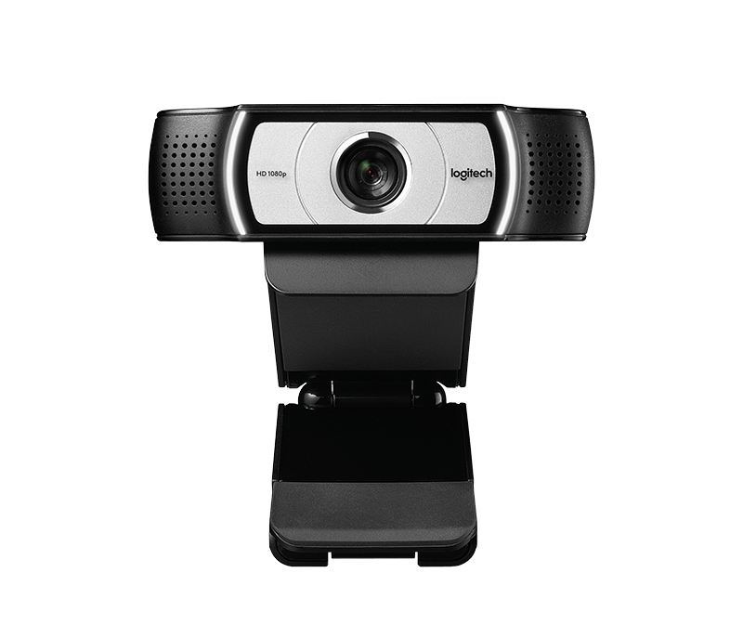














Personal and Mobile device solutions…
Personal Workspace
Mobile Workspace
BT Headset devices
Webcam devices
Puck devices
USB Headset devices
Bluetooth devices
Notes:
We introduced Skype Room Systems in late 2016, and we’re seeing strong momentum with these devices from customers because
Our Personal and Mobile device category continues to expand servicing the need to support our everyday working style and location of work. We see how devices play a critical role in the both the overall experience with Skype for Business and Teams and the ability to increase adoption across the workforce.
A key to success factor in a deployment is understanding the individual working persona and allowing for our partners devices to be aligned to this, bringing a sense of completion to the overall experience. We continue to work with our partners in bring new and exciting devices to market that are intuitive and easy to use. In summary our devices category is broken in to following key areas: Corded Headsets, Bluetooth, Wireless, Speaker Pucks, WebCams and IP Phones.

Slide 33
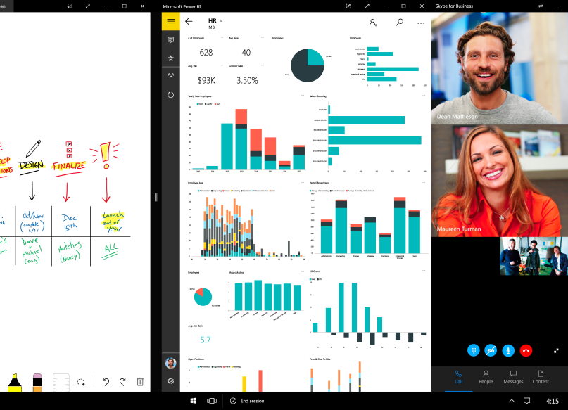
Unlock the power of the group with Teams on Surface Hub
Teams and Teams meetings accessible via browser
Native Teams app experience on future roadmap
Notes:
We want to enable collaborative workspaces where team members want to meet and work together.
Surface Hub supports Teams meetings today in a browser via the Teams web application.
Next year, mid-calendar year, we’re planning to deliver a native Teams app experience for a single-click join experience.

Slide 34
Skype-to-Teams customer experience journey
What can you do now?
September 2017
H1 CY2018
H2 CY2018
CY2019
Hub for teamwork
Chat, presence
Meetings, audio conference
Voice, phone system
Skype for Business
Microsoft Teams
Skype for Business capabilities will be coming to Teams over time
Evaluate your needs relative to the schedule of feature delivery on the Microsoft Teams roadmap
Begin using Teams today to explore the benefits of the hub for teamwork in Microsoft 365
Run Teams side by side with Skype for Business until Teams meets your business needs
Notes:
Individual capabilities will be released according to this schedule. The dates listed are targets for the delivery of a complete set of Skype for Business capabilities in Teams.
Evaluate your needs relative to the schedule.
Begin using Teams today to explore the benefits of the hub for teamwork in Microsoft 365.
Get started by running Microsoft Teams and Skype for Business side by side.

Slide 35
Microsoft 365: Universal Toolkit for Teamwork
Outlook
SharePoint
Yammer
Office Apps
Teams
Email & Calendar
Intranets & Content Management
Connect Across
the Organization
Co-Author
Hub for Teamwork
Office 365 Groups
Single team membership across apps and services
Microsoft Graph
Suite-wide intelligence connecting people and content
Security and Compliance
Centralized policy management
Notes:
Objective: Reinforce our teamwork position - Microsoft 365 meets the diverse needs of teams with an integrated solution that is secure
We’ve designed Microsoft 365 to meet the unique needs of every group.
For each of those categories of teamwork, Microsoft 365 includes a purpose-built application.
Teams as a hub for teamwork where groups that actively engage and are working on core projects can connect and collaborate
Yammer for people to connect across their company, sharing ideas on common topics of interest
Outlook where teams can communicate in a familiar place, and can easily create modern distribution list with groups in Outlook
SharePoint for keeping content at the center of teamwork, making files, sites and all types of content easily shareable and accessible across teams
Office Apps – enabling co-authoring in familiar apps like Word, Excel, and PowerPoint
With these tools coming together in Microsoft 365 – teams get a holistic solution.
What’s unique about teamwork in Microsoft 365 is that all of these applications are built on an intelligent fabric - suite-wide membership service with O365 Groups; suite-wide discovery and intelligence with Microsoft Graph, and suite-wide security and compliance.
Office 365 Groups - A membership service providing a single identity for teams across Office applications and services
Microsoft Graph - Suite-wide intelligence that maps the connection of people and content to surface insights
Security and Compliance - Proactive security that simplifies IT management with intelligence built-in

Slide 36
Customer Evidence Library

Slide 37


Trek Bicycle
Use Case
Teams around the world
Chat + files in one place
Video meetings
How They’re Using Microsoft Teams:
“Insights from Microsoft Power BI have been a game changer for us. It has enabled us to be more productive, as well as better allocate our time and resources – and when combined with the rest of the Microsoft solutions, it’s helping Trek break out further from the pack.”
David Peterson, Enterprise Collaboration Manager
Trek Bicycle
Trek Bicycle Case Study
Notes:
Talk track notes:
Trek Bicycles was one of our launch customers. They are a global manufacturer of bicycles. These scenarios are especially important to them.
Video: https://www.youtube.com/watch?time_continue=3&v=glMfn6alMyY

Slide 38

J. Walter Thompson
Use case
Distributed workforce
Single, shared workspace
Intuitive interface
How They’re Using Microsoft Teams:
“Our employees have been surprised and delighted with the intuitive interface and the ability Microsoft Teams gives them to mobilize people in a way we’ve never seen before. It’s easy to onboard people mid project, and it works well on a Mac. And like all the other Office 365 apps, we get the structure and security that makes us comfortable with Microsoft cloud solutions.”
Jamie McLellan, Chief Technology Officer
J. Walter Thompson
J. Walter Thompson Case Study
Notes:
J. Walter Thompson
Global teams
Power of files and chat all in one place – persistent so can review at any time
UI mirrors how we work as humans
Case study: https://customers.microsoft.com/en-us/story/jwt-professional-services-microsoft-teams
Video: https://www.youtube.com/watch?v=oZrynUTuyf0&feature=youtu.be

Slide 39

Dentsu Aegis Network
Use case
Virtual teams across regions
Viral adoption
Open work culture
How They’re Using Microsoft Teams:
“We used Power BI to pull data from each group and combine it into one view. This is a lot more efficient than our previous process…once we finish creating automatic import functions to move data from Microsoft Excel into a Power BI dashboard, we’ll reduce the time it takes to prepare the reports by approximately 60 percent—up to four or five days a month.”
Sunil Yadav, President, Amplifi Asia Pacific
Dentsu Aegis
Dentsu Aegis Network
Notes:
Dentsu Aegis Network
Fast rollout - “With minimal internal promotion and after just three months, we have 600 employees in 20 different digital and media brands working in Microsoft Teams collaboration hubs.
Open communication drives increased collaboration - Previously, brands tended to work in silos, but today, they have one space where they can coordinate deliverables for the same client with real-time chat, shared files, and OneNote notebooks
Case study: Dentsu Aegis Network

Slide 40


Three
Use Case
Global teams
Central workspace
Natural adoption
How They’re Using Microsoft Teams:
“The real advantage of Microsoft Teams is that you’re more productive because you don’t have to constantly switch between productivity apps. With Microsoft Teams, it’s contextually evident when to use the different Office 365 services—Skype for Business Online to start a meeting, OneNote to organize meeting minutes, and SharePoint Online or Microsoft OneDrive for Business to save your document.”
Gary Walker, Head of People Digital Tools
Three
Three Case Study
Notes:
Three
Global teams with 24/7 productivity
Increased productivity due to having all apps accessible via a central workspace
Natural adoption of Teams and O365 apps due to ease of use
Case study: Three Case Study

Slide 41
Hendrick Motorsports
Use Case
Multiple teams, locations
Single UI
Long-term chat history
How They’re Using Microsoft Teams:
“We conduct simultaneous tests, sharing and syncing large Microsoft Excel files through Microsoft Teams and SharePoint Online to compare results in almost real time. Now we don’t have to wait until the engineers come back from the wind tunnel to review the data. We refine our analyses of the car’s aerodynamic capabilities on the fly, get more tests done before the race, and build a faster car.”
L.Bryce Whitson Jr., Aerodynamics Engineer Hendrick Motorsports
Hendrick Motorsports Case Study
Notes:
Talk track notes:
Hendrick Motorsports is a race car engine manufacturer and racing team. Not the traditional team you might think of – they have people in the factory, people in the back office, and people on the track in the pit crew, all using Microsoft Teams. These scenarios are important to them.
Case study: Hendrick Motorsports Case Study

